Slide 1



MagTracer: Detecting GPU Cryptojacking Attacks via Magnetic Leakage Signals
Rui Xiao, Tianyu Li, Soundarya Ramesh, Jun Han, Jinsong Han

Slide 2
Cryptojacking Attack
I want to mine cryptocurrency
using victim’s computing devices.
Attacker

Slide 3



Cryptojacking Attack
Cryptojacking Malware Injection
Attacker
Cryptocurrency Earned
Malware Running Stealthily
Victim 1
Victim 3
Victim 2

Slide 4


Prevalence of Cryptojacking
Share of Malware in 2022 Q3
Attack Actions in Cloud in 2021
Resource:
Resource: Google Cloud
4

Slide 5
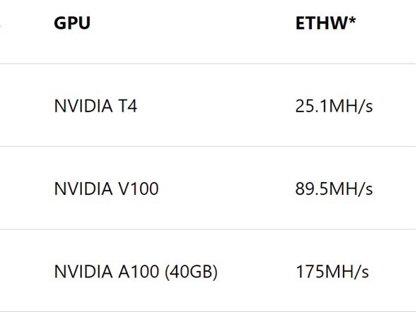
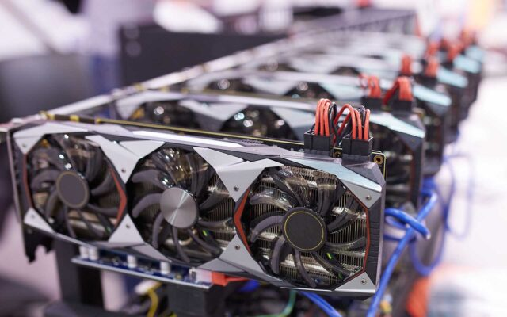
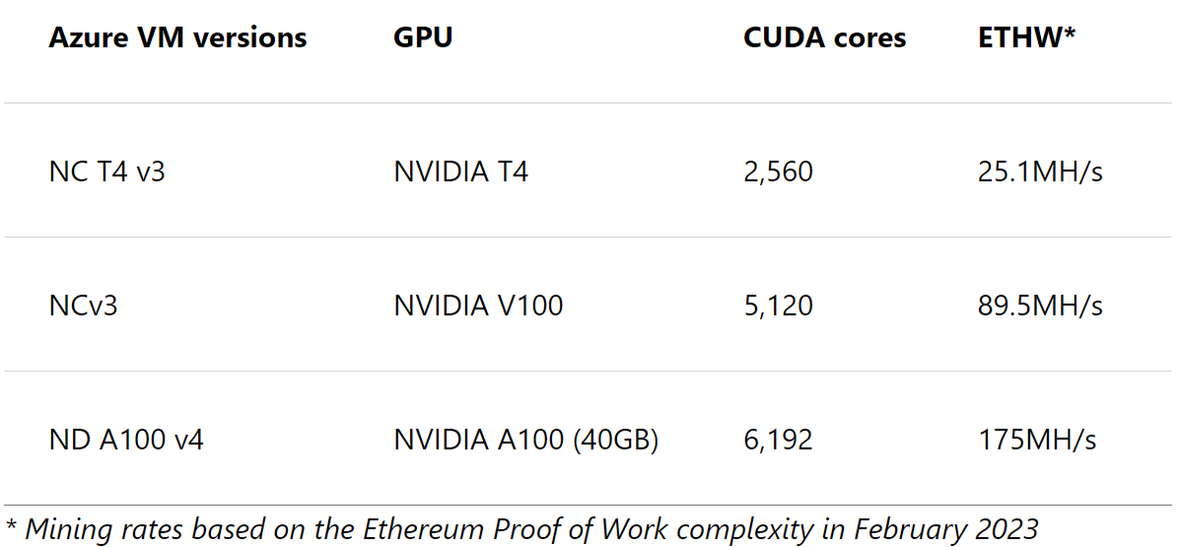

GPU-Targeted Cryptojacking
GPUs are powerful miners
Profitability for attackers
Huge Loss for victims
GPU Mining
Cryptojacking were seen to incur compute fees more than $300,000.

Slide 6



Existing Cryptojacking Defenses
Maintain a blacklist of malicious sites
Not Scalable [1]
Network flow monitoring
Prone to proxies and encrypted communication [2]
Runtime-based detection: CPU usage, RAM usage, system calls, etc.
Not applicable to GPUs
Compromised through system vulnerabilities [3]
[1] Paint it black: Evaluating the effectiveness of malware blacklists. Kührer et al. (RAID’ 14)
[2] MINOS: A lightweight real-time cryptojacking detection system. Naseem et al. (NDSS’ 21)
[3] Obfuscation revealed: Leveraging electromagnetic signals for obfuscated malware classification. Pham et al. (ACSAC’ 21)

Slide 7
Existing Cryptojacking Defenses
Not Scalable [1]
Can we design a GPU cryptojacking defense that realizes –
Network flow monitoring
a) Scalability to unseen cryptojacking malware across different GPUs,
Prone to proxies and encrypted communication [2]
b) Resilience to attacks from powerful remote attackers.
Runtime-based detection: CPU usage, RAM usage, system calls, etc.

Slide 8




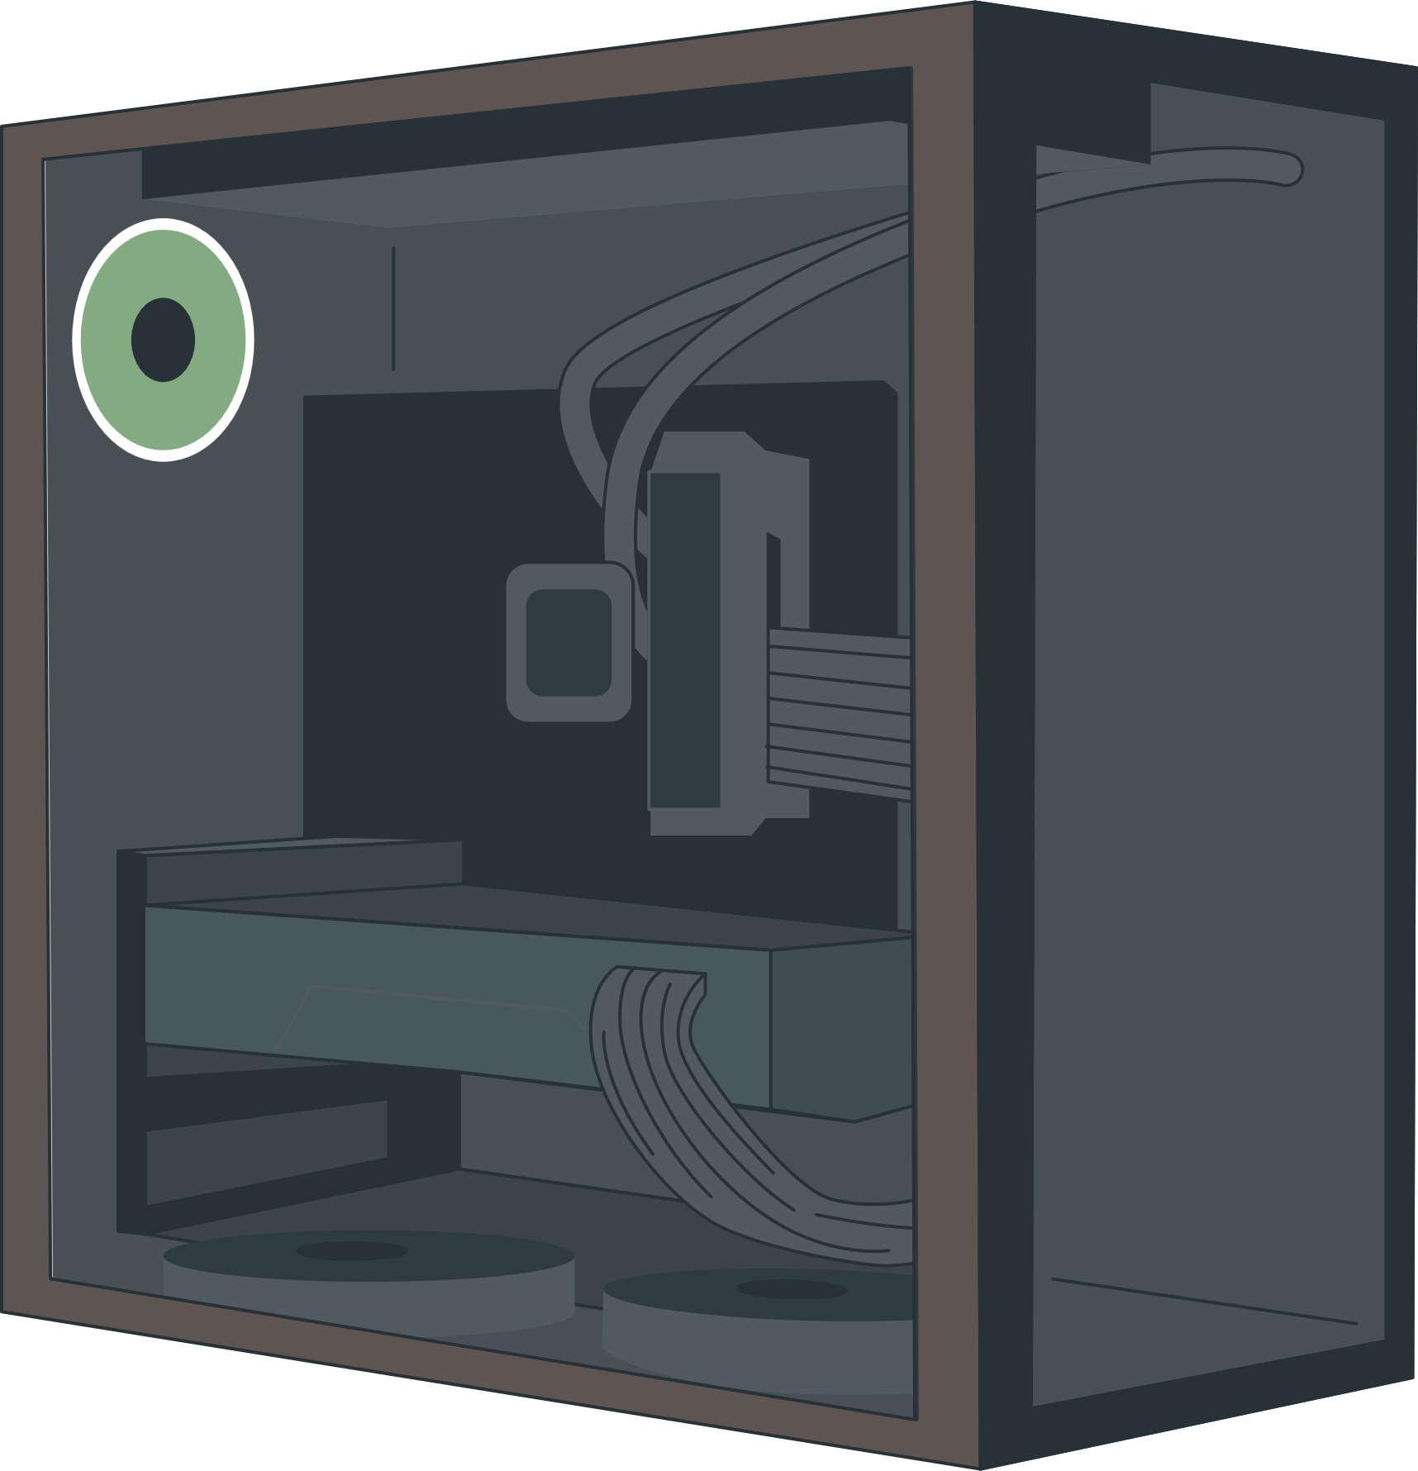



MagTracer: Our Solution
A novel Magnetic Leakage-based GPU Cryptojacking Detection
Magnetic Signals
Magnetic
Signature
Cryptojacking Detected
Remote
Attacker
MagTracer
Hardware
Magnetic
Emanation
Cryptojacking
Malware
Victim’s
GPU Machine

Slide 9
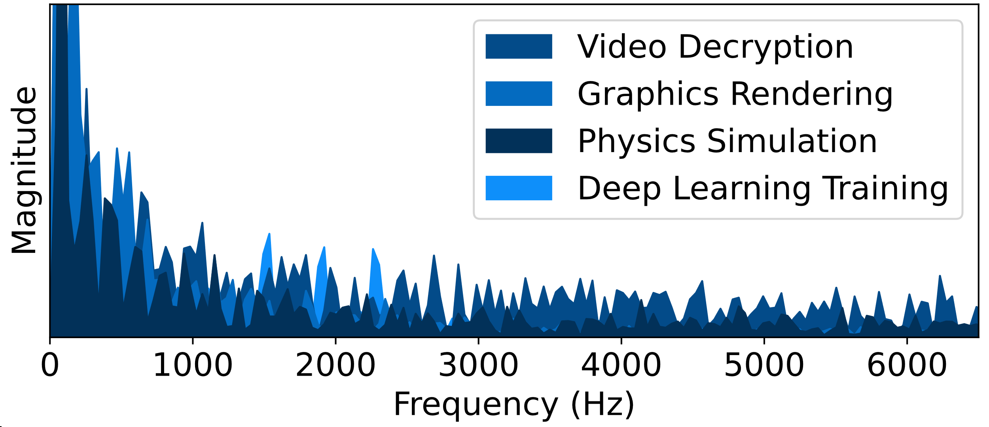
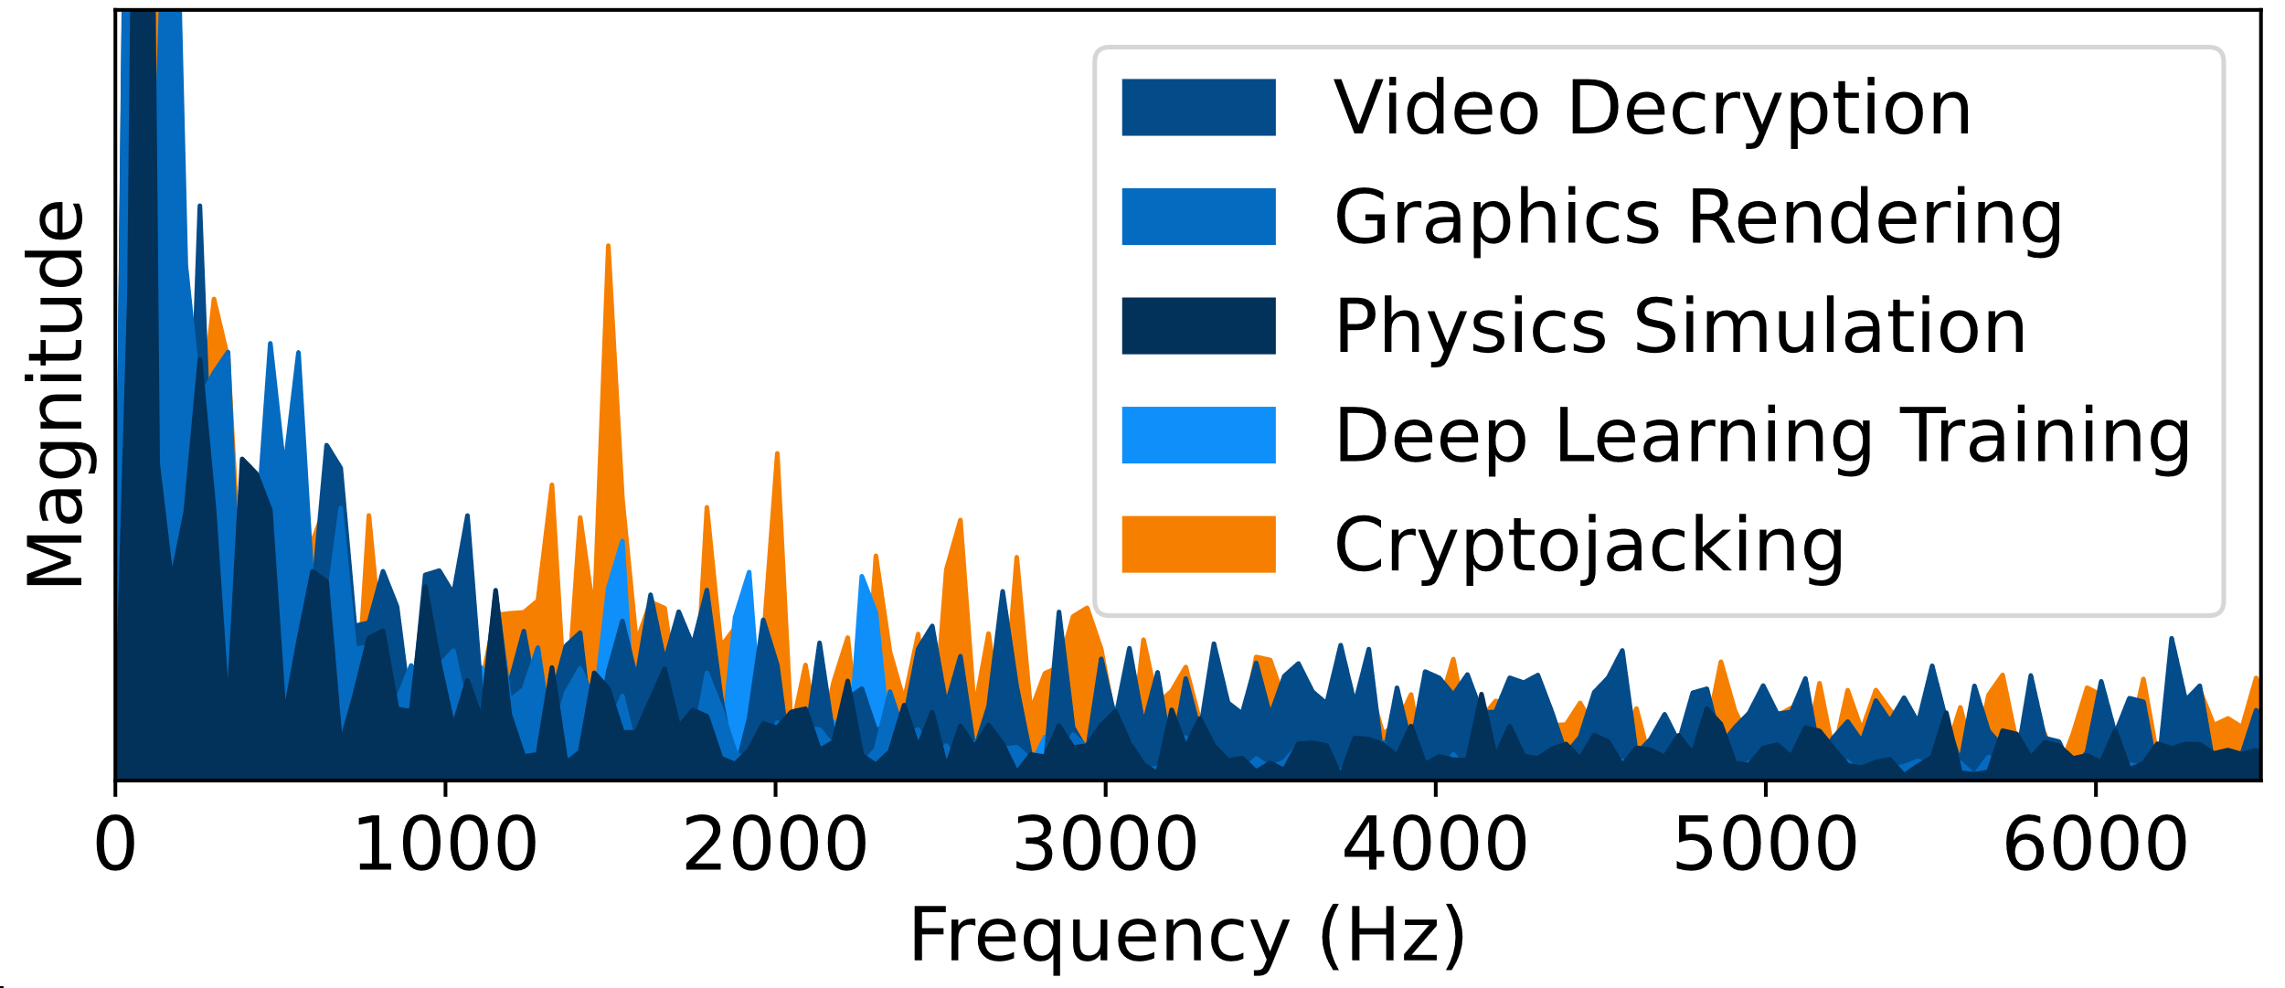
Key Insight: Distinct Magnetic Signature
Magnetic Emanation Collection
for cryptojacking detection
Mining Signature
Magnetic
Emanation
Question: Is this mining signature
consistent and unique to mining?
representative benign GPU tasks
representative GPU tasks
Mining signature stems from the unique characteristics of cryptomining.
Yes!
GPU Cryptojacking
GPU Cryptojacking

Slide 10
Primer: Unique Characteristics of Mining
GPU iteratively executes the mining algorithm
Mining
Algorithm
Mining
Algorithm
Mining
Algorithm
…
Mining
Algorithm
GPU Execution
Hash Computation
Intensive Memory Readings
Compute-Block
Memory-Block
Characteristics 1: Computationally Intensive
Characteristics 2: Memory-bounded

Slide 11
Primer: Unique Characteristics of Mining
GPU iteratively executes the mining algorithm
…
C
M
C
M
C
M
…
C
M
GPU Execution
Hash Computation
Intensive Memory Readings
Compute-Block
Memory-Block
Characteristics 1: Computationally Intensive
Characteristics 2: Memory-bounded

Slide 12
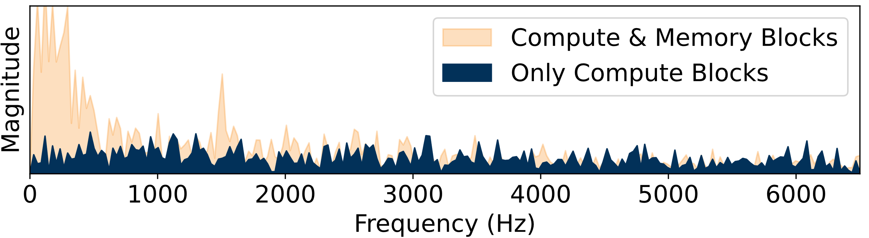
Generation of Mining Signature
C
C
C
…
C
GPU Execution
No Mining Signature
Characteristics 1: Computationally Intensive
Characteristics 2: Memory-bounded
Require this
unique combination

Slide 13
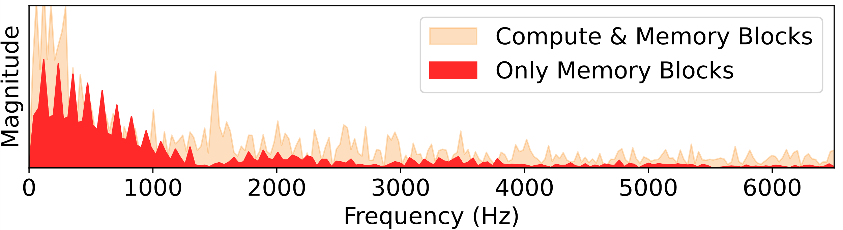
Generation of Mining Signature
M
M
M
…
M
GPU Execution
No Mining Signature
Characteristics 1: Computationally Intensive
Characteristics 2: Memory-bounded
Require this
unique combination

Slide 14
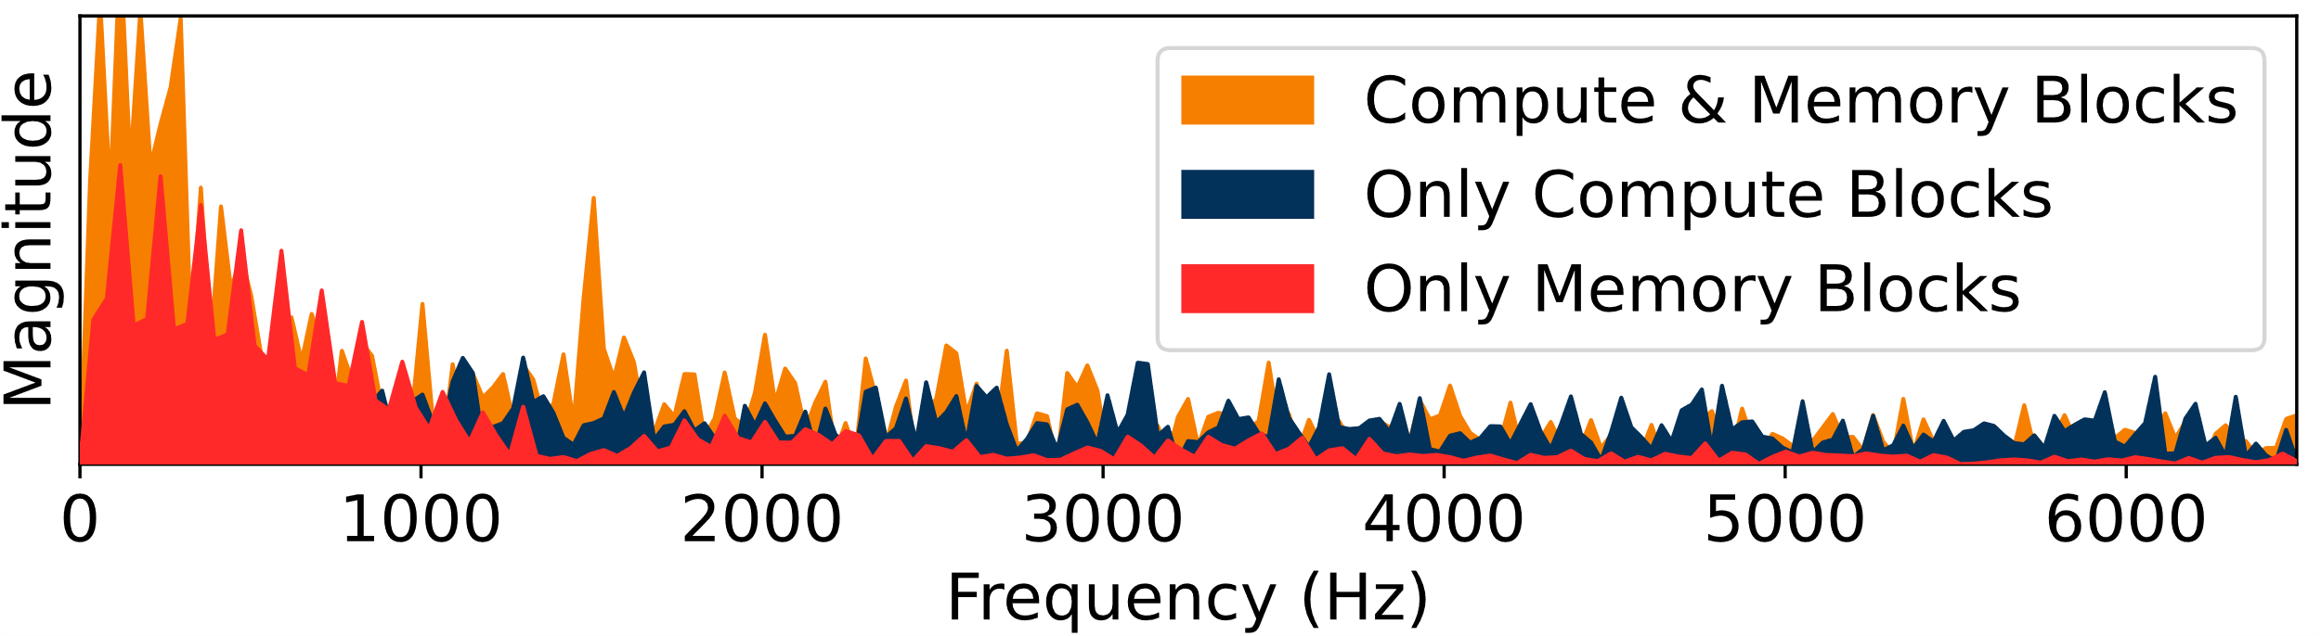
Generation of Mining Signature
C
M
C
M
C
M
…
C
M
GPU Execution
Mining Signature
Characteristics 1: Computationally Intensive
Characteristics 2: Memory-bounded
Require this
unique combination

Slide 15
Generation of Mining Signature
C
M
C
M
C
M
…
C
M
GPU Execution
No Mining Signature
No Mining Signature
Mining Signature
Mining Signature
The “compute + memory”-based mining signature is a reliable indicator of cryptojacking.
Characteristics 1: Computationally Intensive
Characteristics 2: Memory-bounded
Require this
unique combination

Slide 16

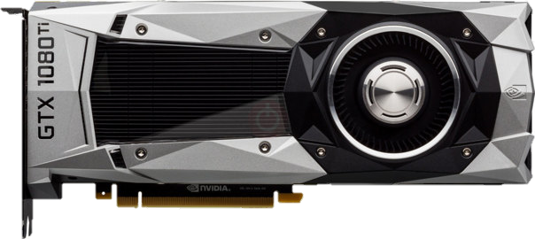
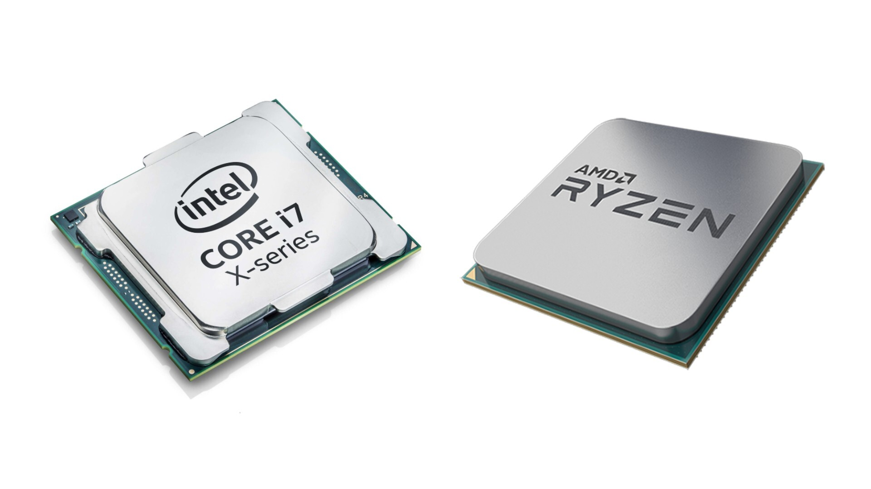
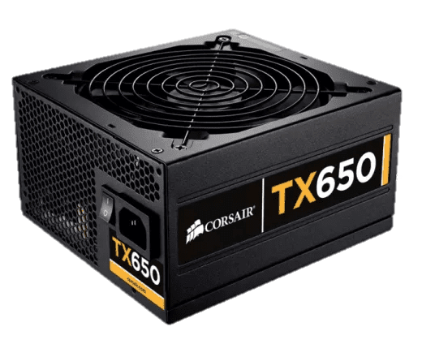
MagTracer: Challenge 1
Noisy Magnetic Side Channels
Weak Mining Signature
External Interferences
Internal Interferences
Cryptojacking
GPU
CPU
PSU
Concurrent Benign Processes

Slide 17
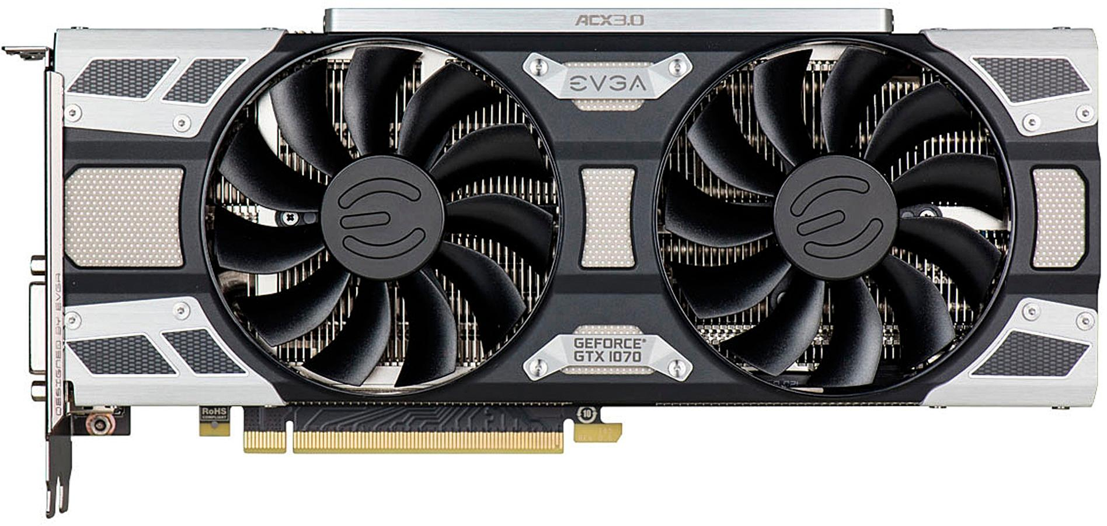
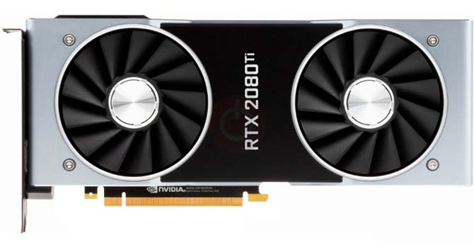
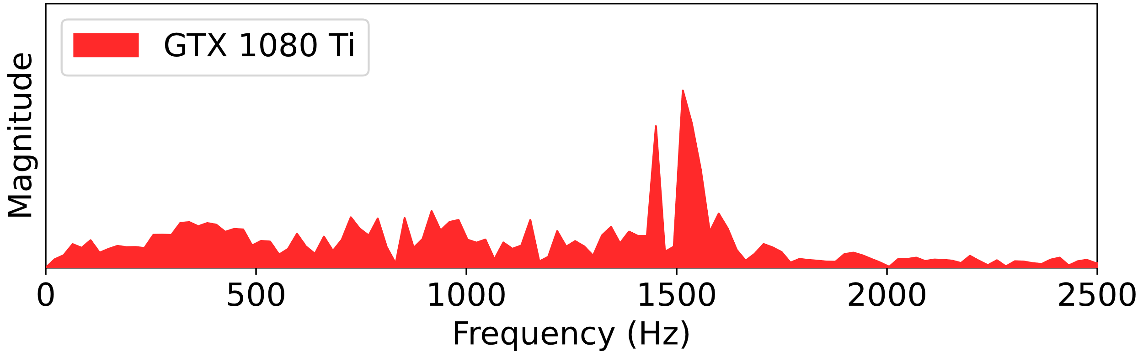
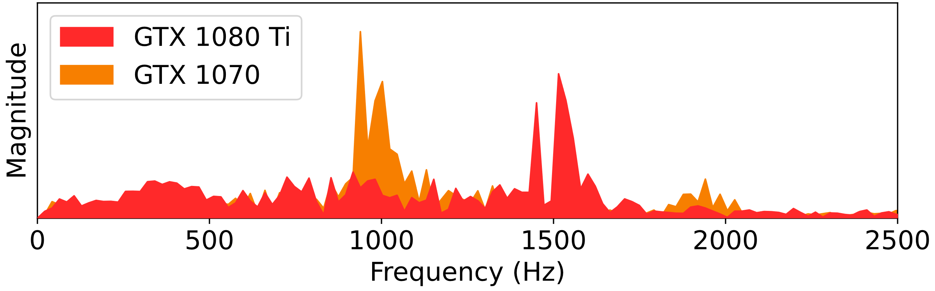
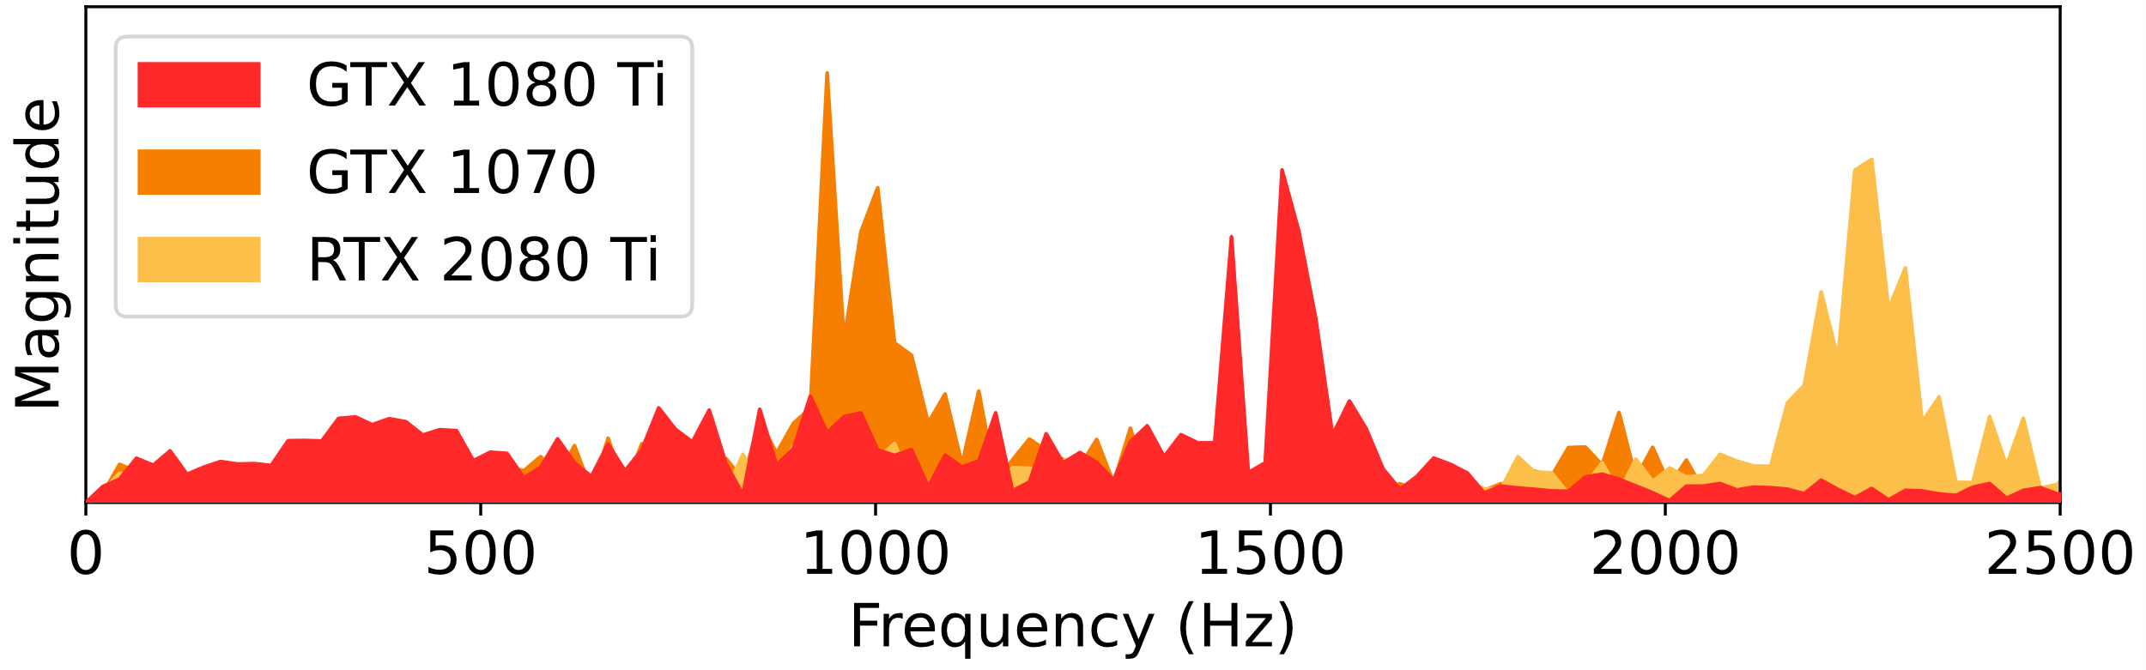
MagTracer: Challenge 2
GPU-Dependent Mining Signature
Different Hardware Specifications of GPUs
Which frequency band to monitor?

Slide 18
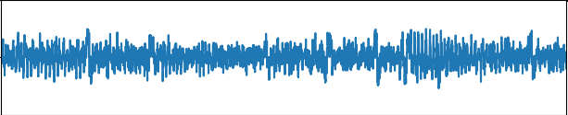
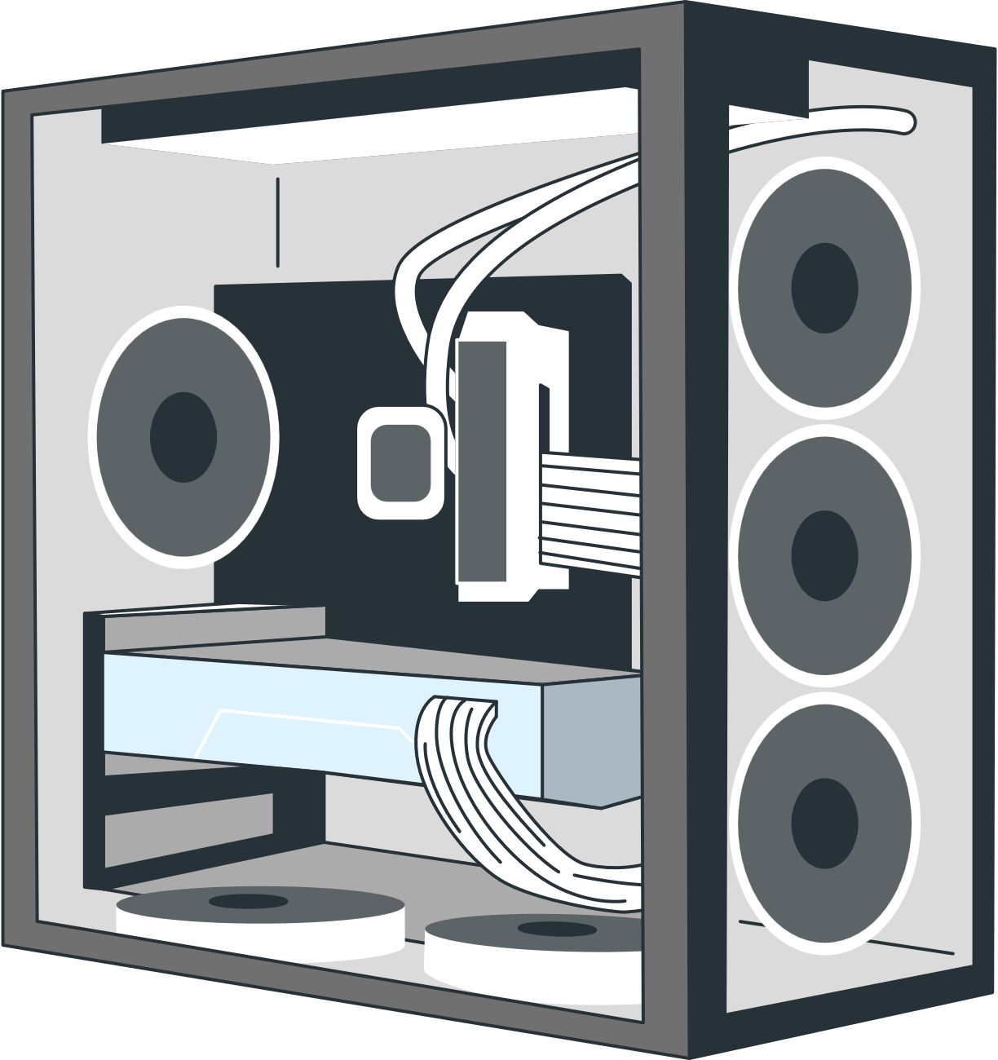


System Design of MagTracer
Bootstrapping Phase
Train Data
To Solve Challenge 1:
Noisy Magnetic Signals
Noise Removal
Feature Extraction
& Aggregation
…
“Benign”
“Mining”
To Solve Challenge 2:
GPU-Dependent Signature
GPU
Mining Frequency
Identification
Model Training
Specs.
Benign
Trained Model
or
Deployment Phase
Mining
GPU
Mining Frequency
Identification
Model Inference
Specs.
Noise
Removal
Feature Extraction
& Aggregation
Test
Data

Slide 19
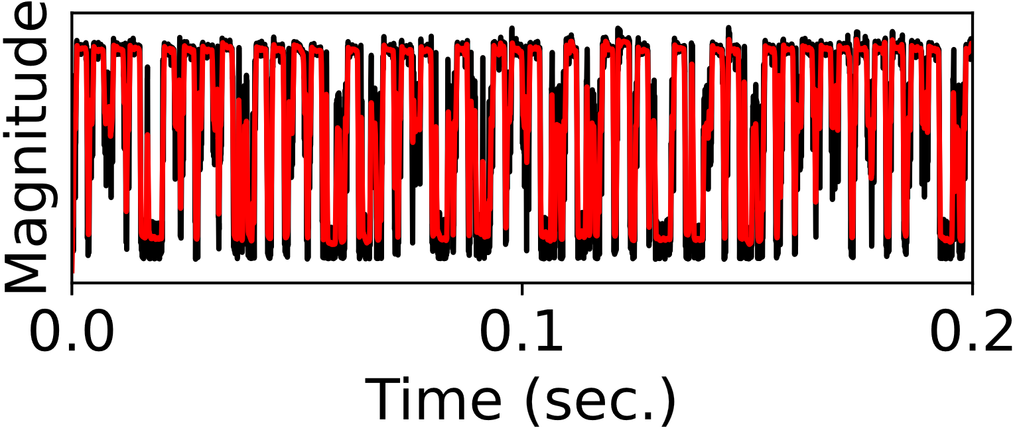
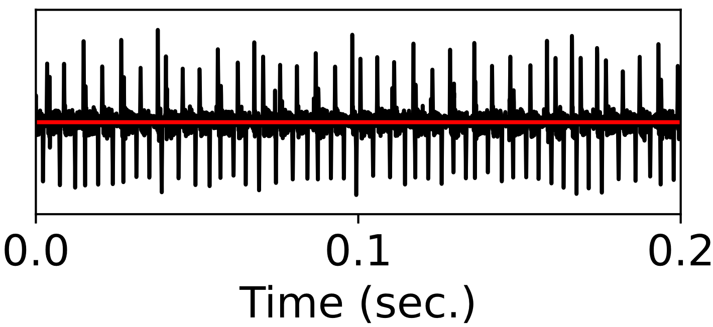
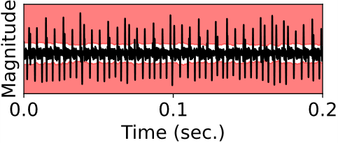
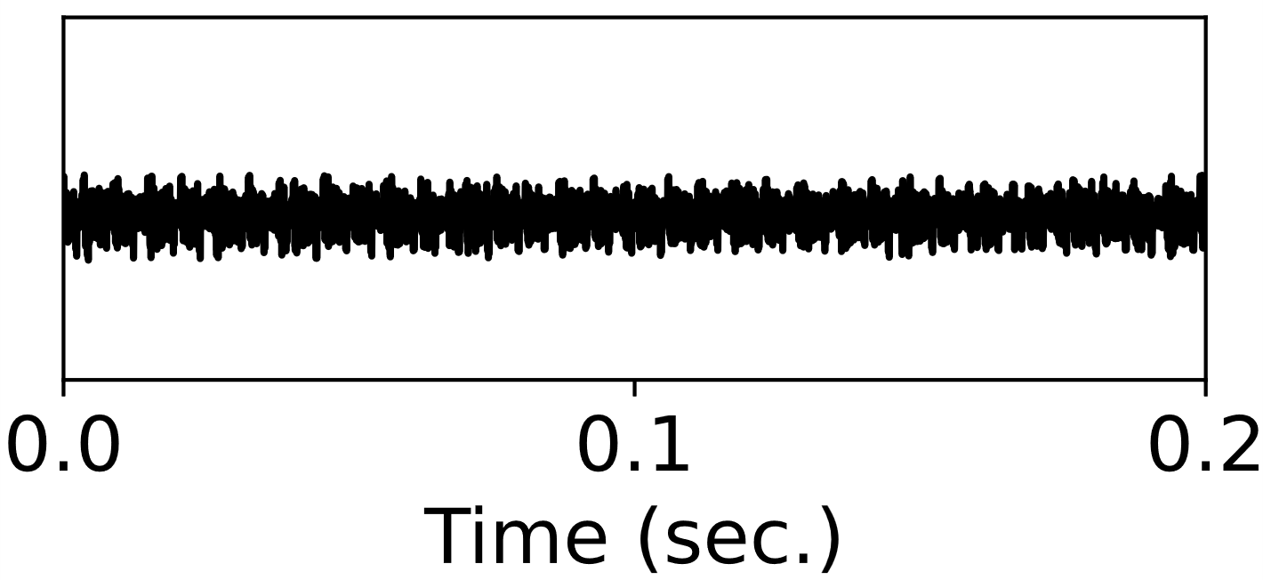
System Design of MagTracer
Bootstrapping Phase
Level Shift: caused by both external and internal noises
Train Data
To Solve Challenge 1:
Noisy Magnetic Signals
Supervised learning
Trend
Signal Detrending
Noise Removal
Feature Extraction
& Aggregation
…
“Benign”
“Mining”
To Solve Challenge 2:
GPU-Dependent Signature
GPU
Mining Frequency
Identification
Model Training
Specs.
Benign
Pulse Noise: caused by external noises
Trained Model
or
Deployment Phase
Outlier Region
Pulse Noise Removal
Mining
GPU
Mining Frequency
Identification
Model Inference
Specs.
Noise
Removal
Feature Extraction
& Aggregation
Test
Data

Slide 20
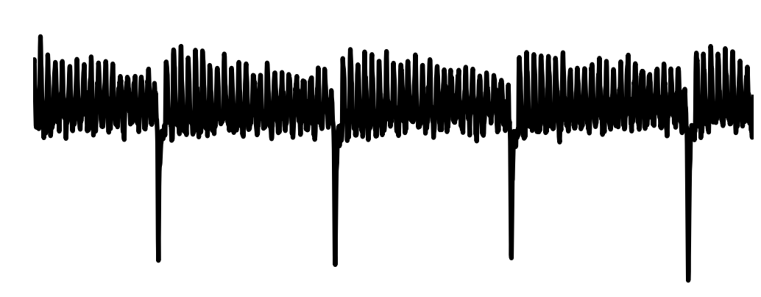
Mining Frequency Identification
Goal: Estimate the mining frequency for any given GPU (for Challenge 2)
Primer: A GPU has multiple Streaming Multiprocessors
When mining, each will be assigned a group of threads to execute
SM
SM
Periodically
SM 1
Threads
Threads
Threads
Threads
Threads
Threads
Threads
GPU
SM 2
Threads
Periodical
Magnetic Emanation
Threads
Threads
Threads
Threads
Threads
Threads
…
SM N
Threads
Threads
Threads
Threads
Threads
Threads
Threads
Magnetic
Magnitude
Time

Slide 21


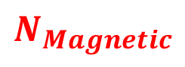



Mining Frequency Identification
Goal: Estimate the mining frequency for any given GPU (for Challenge 2)
Primer: A GPU has multiple Streaming Multiprocessors
When mining, each will be assigned a group of threads to execute
SM
SM
Periodically
SM 1
Threads
…
Threads
Threads
Threads
GPU
SM 2
Threads
…
Periodical
Magnetic Emanation
Threads
Threads
Threads
…
SM N
Threads
…
Threads
Threads
Threads
Assign 1
Assign 2
Assign N
$$N_{Assignments}$$
$$N_{Magnetic}$$
$$N_{Magnetic}$$
$$=$$
$$N_{Assignments}$$
N Assignments
Time
Time
Thread Assignment Frequency
Magnetic
Magnitude
$$=$$
Mining Frequency
GPU Specifications
N Magnetic Peaks
(HashRate, Number of SM, Registers)
Time

Slide 22
Mining Frequency Identification
Goal: Estimate the mining frequency for any given GPU (for Challenge 2)
Primer: A GPU has multiple Streaming Multiprocessors
When mining, each will be assigned a group of threads to execute
SM
SM
Periodically
SM 1
Threads
…
Threads
Threads
Threads
GPU
SM 2
Threads
…
Periodical
Magnetic Emanation
Threads
Threads
Threads
…
SM N
Threads
…
Threads
Threads
Threads
Assign 1
Assign 2
Assign N
$$N_{Magnetic}$$
$$N_{Assignments}$$
Thread Assignment Frequency
$$=$$
N Assignments
Mining Frequency
Magnetic
Magnitude
GPU Specifications
GPU Specifications
(HashRate, Number of SM, Registers)
N Magnetic Peaks
(HashRate, Number of SM, Registers)
Time

Slide 23
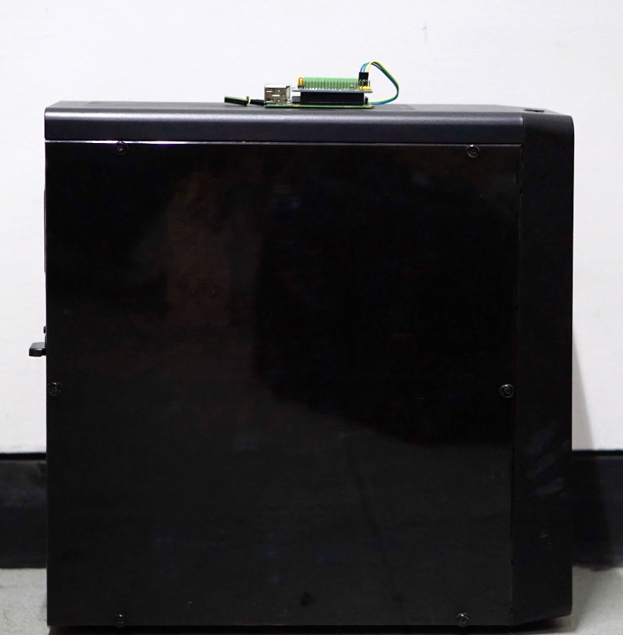
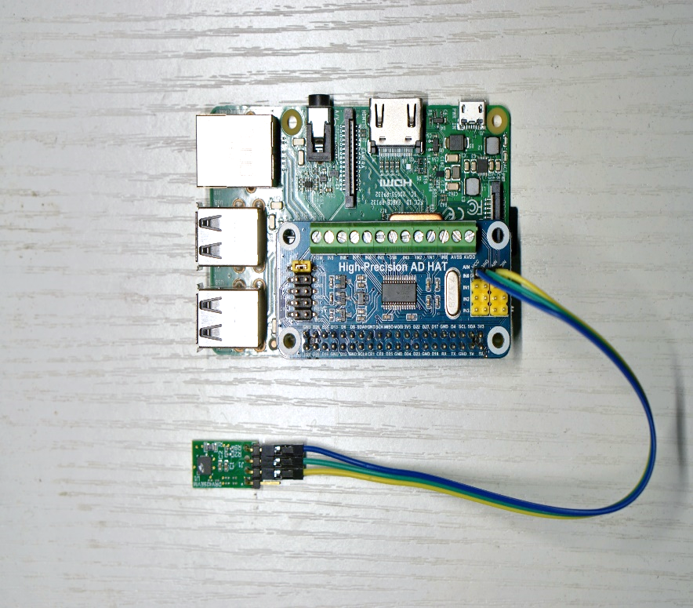
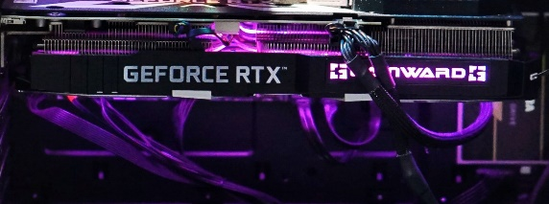
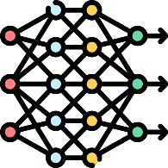

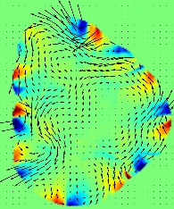
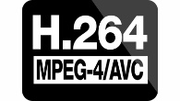




Prototyping & Evaluation
Magnetic Sensor
RPi
Side Panel
COTS Devices (~$40)
GPU Inside
14 Heterogenous GPUs
Released in the past 6 years
5 Different Architectures
ADC
MagTracer Prototype
Protected Host
Cryptojacking vs. 80 Benign Tasks:
Deep Learning Training
Video
Encoding
Signal
Processing
Physics Simulation
Games
Cryptography
Statistics
Optimization

Slide 24
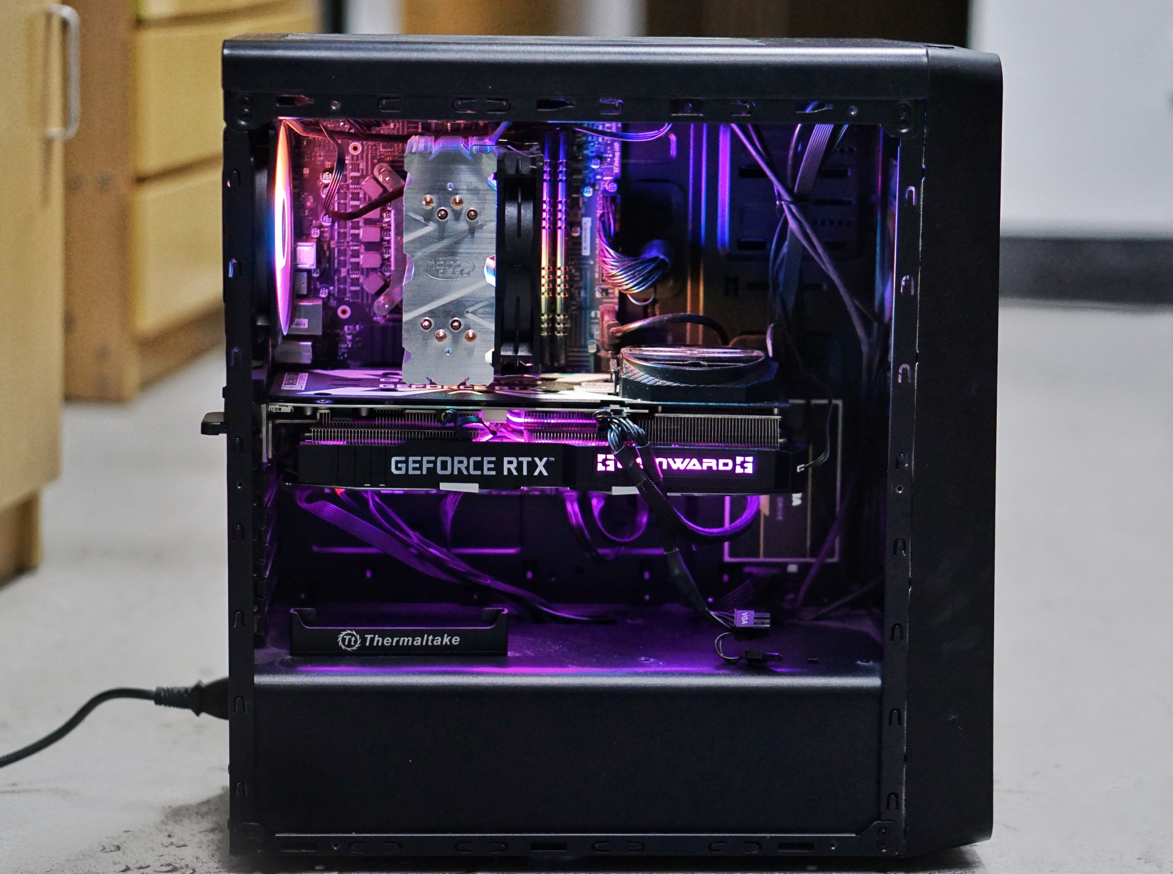
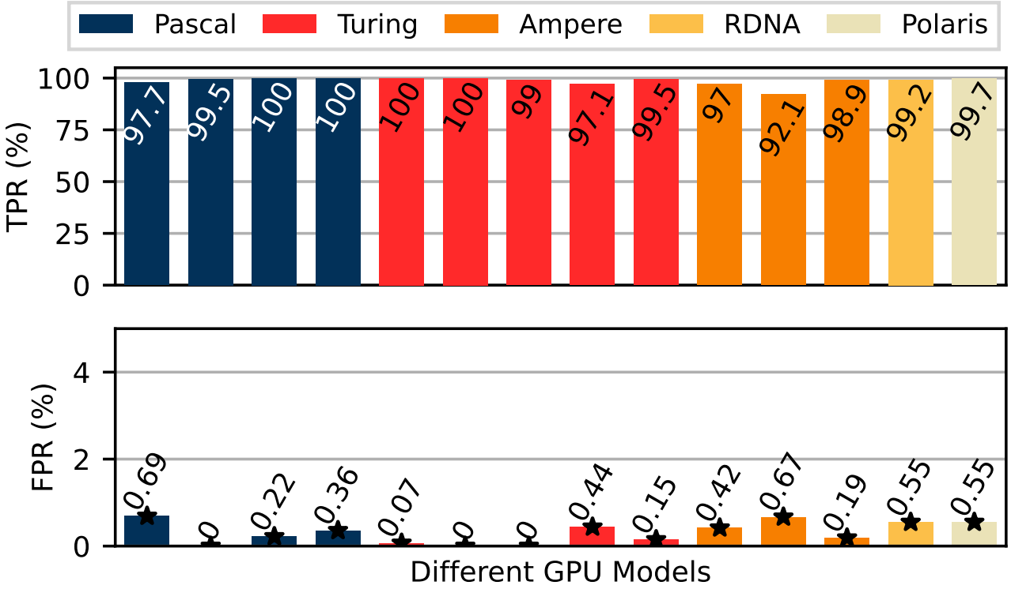
Prototyping & Evaluation
Magnetic Sensor
RPi
Side Panel
COTS Devices (~$40)
GPU Inside
14 Heterogenous GPUs
Released in the past 6 years
5 Different Architectures
ADC
MagTracer Prototype
Protected Host
Cryptojacking vs. 80 Benign Tasks:
Overall Detection Result
True Positive Rate (TPR): 98.6%
False Positive Rate (FPR): 0.69%

Slide 25
Summary of Evaluation Results
Generalizes across unseen 5 mining software and 6 cryptocurrencies
Works at 24 cm from the host with a metal case
Detects cryptojacking in real-time (0.5s)
Robust against binary obfuscation and targeted attacks

Slide 26
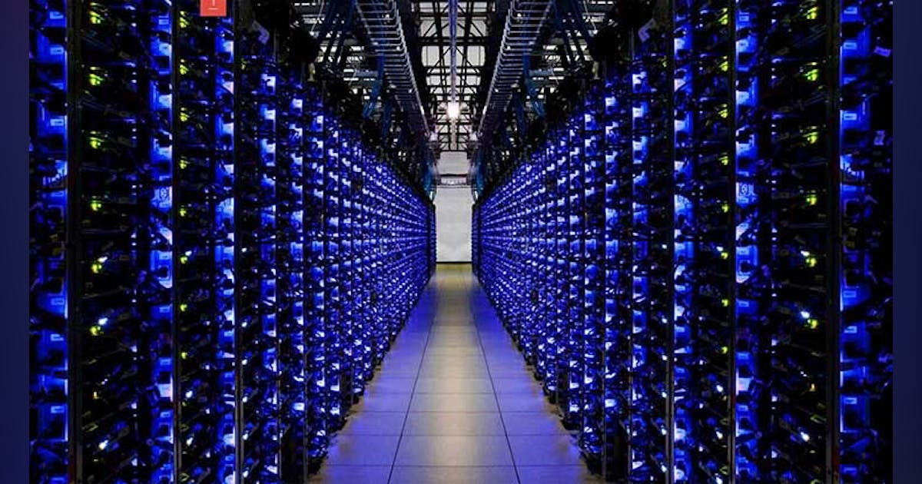
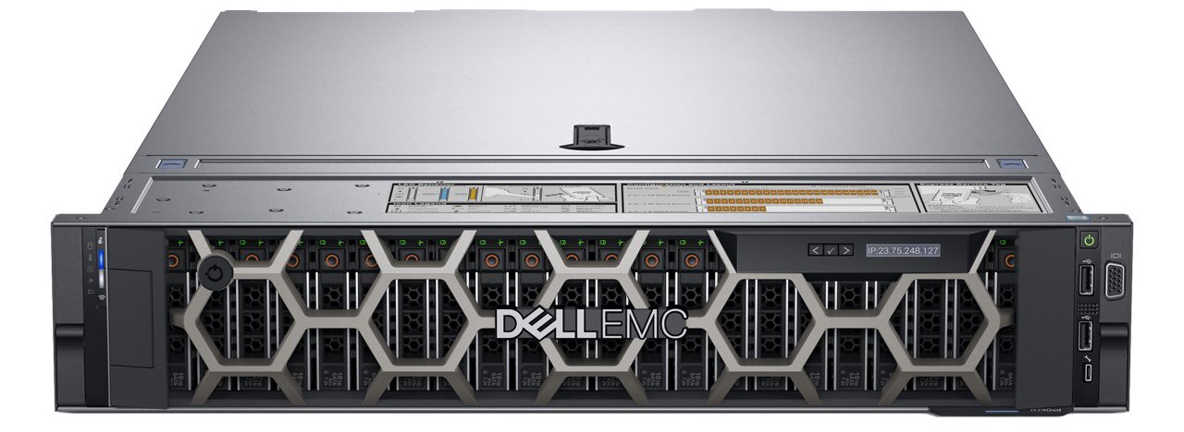
Considerations for Real-World Deployment
Applications in server rooms and data centers with machines equipped with multiple GPUs.
Strategically position the sensor
Miniaturize the form factor on a single printed circuit board
Most Common Width: 48.2 cm
Server Room
Multi-GPU Server

Slide 27
Conclusion
MagTracer uses GPU magnetic emanation as a proxy for cryptojacking detection.
We hope to extend our detection to hosts with multiple GPUs.
Magnetic Signals
Mining
Signature
Cryptojacking Detected
Remote
Attacker
MagTracer
Magnetic
Emanation
Cryptojacking
Malware
Victim’s
GPU Machine

Slide 28

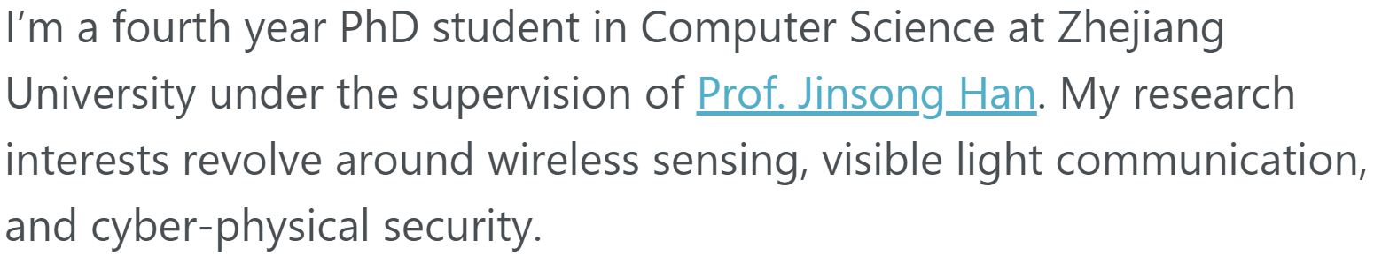
Thank you!
ruixiao24@zju.edu.cn
Rui Xiao
ruixiao24.github.io
PhD candidate at Zhejiang University

